Slide 1
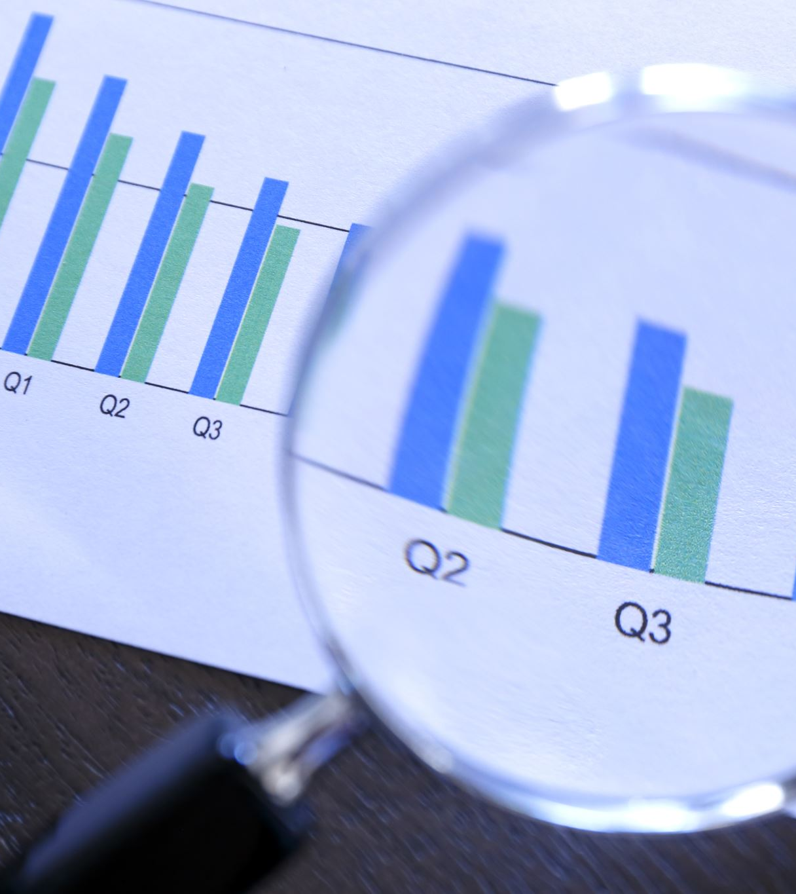
GDP ANALYSIS
-Kusuma Nara

Slide 2
Approach
Data Import and Preparation: The initial step involves importing data from a Google Sheet into separate Pandas data frames and reshaping the data into a long format. This allows for further analysis and visualization across different years.
1
Data Merging: Combined the GDP_PPP data frame, converted to long form using the melt function to facilitate analysis over time, with the data frame containing independent variables (IVs). Modified the data frame by merging them based on common columns ('country' and 'Year'). This integration enables a comprehensive examination of the relationship between country branding and economic indicators.
2
Missing Data Imputation: Linear regression is utilized to predict missing GDP_PPP values, ensuring data completeness for analysis. As there was a significant change when replaced by the mean/median. Hence Linear regression was used to predict the missing value that followed the market flow.
3
Interactive Visualization: Creating an interactive Dash application enables users to explore the relationship between a country's GDP_PPP and selected features. Dropdown menus allow for a dynamic selection of countries and features, providing a user-friendly interface for data exploration.
4
Model Development: The model is developed with standardized data to ensure proper interpretability. The model evaluates each country’s performance, summarizing results including coefficients and mean absolute percentage error (MAPE). This analysis provides insights into the models' predictive power and features' influence on GDP_PPP.
5
Feature Importance Identification: Top features impacting GDP_PPP for each country are identified using coefficients from the Linear regression model for each country(Because we have standardized the data, we can consider that the highest coefficient feature is most effective). This allows for identifying key drivers of economic growth and branding effectiveness country-by-country.
6

Slide 3
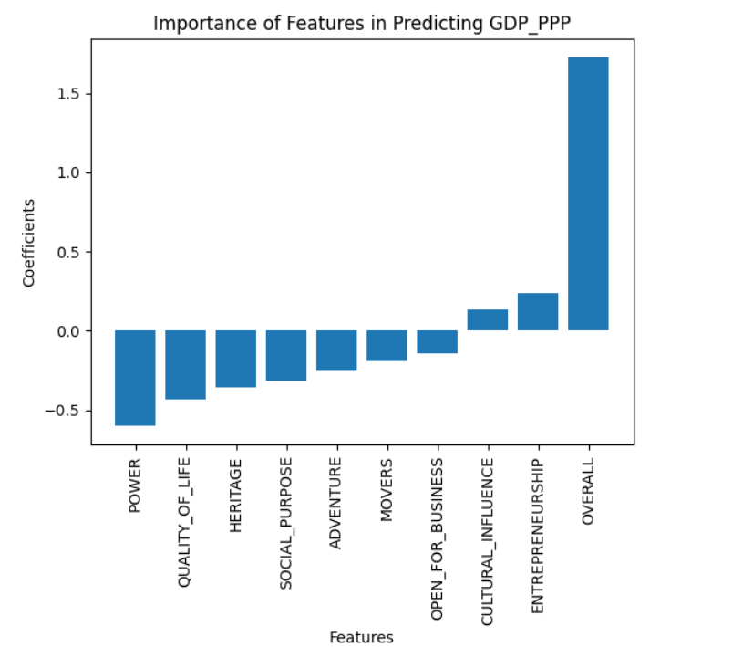
Most important factor across all countries for improving GDP_PPP & How much does improving each factor improve GDP?
From the model coefficients, it's evident how much each factor will affect the GDP.
The features "power" and "overall" have the most significant impact on the GDP across all countries.

Slide 4
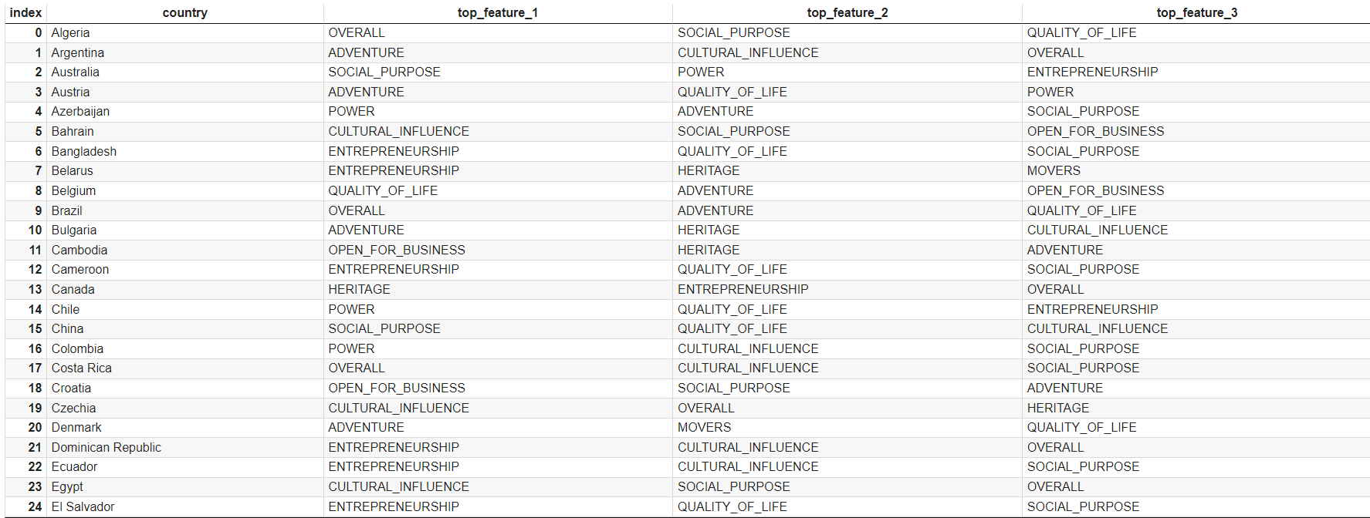
Which factors are most important for which countries (heterogeneity)?
These are the top features effecting each country(the rest can be observed in the code)

Slide 5
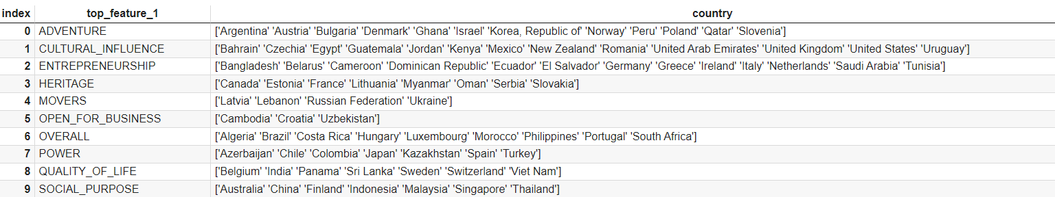
Grouping countries into segments based on Top factor
These are countries grouped according to their specific Top factor

Slide 6
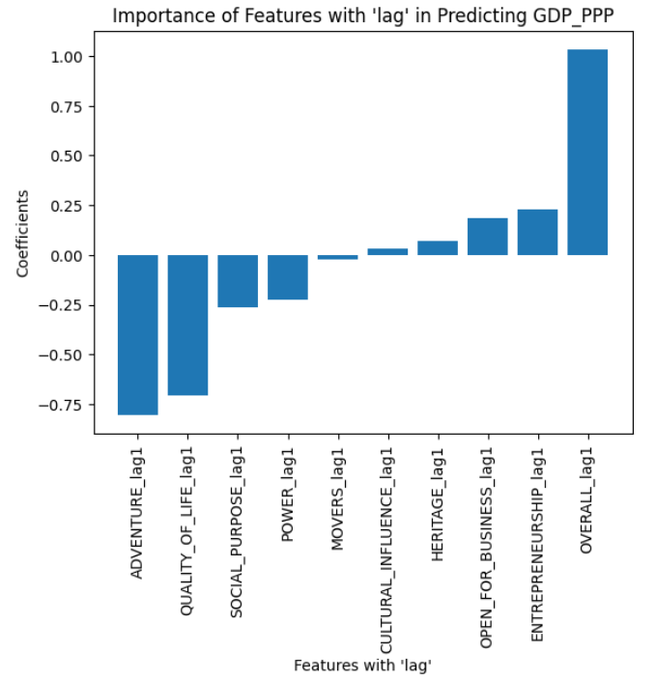
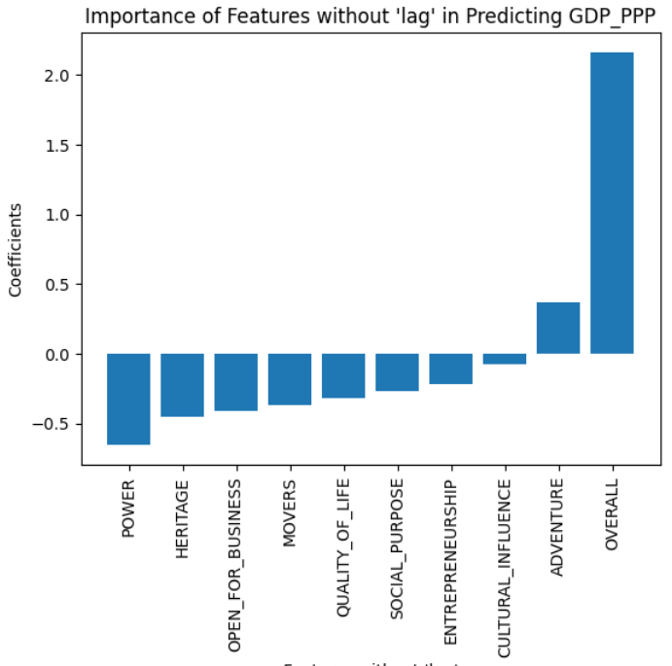
Yearly GDP_PPP with the country factor scores from the same year and before
Incorporating lag features from the previous year reveals how past conditions affect current GDP, with positive coefficients indicating increases in lag feature values leading to higher GDP and negative coefficients suggesting the opposite. This temporal analysis enhances our understanding of GDP predictors' dynamics over time, with graphical representation facilitating visual comparison between features with and without lag.

Slide 7
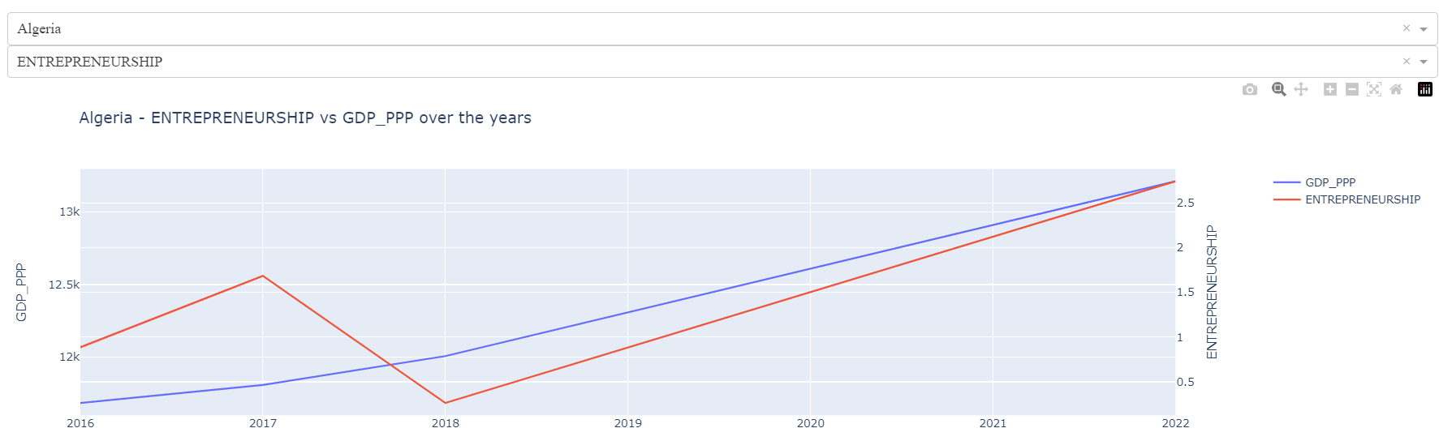
Time Series Analysis
Performed time series analysis for each country across the years 2016-2022 to examine the relationship between GDP and each factor, aiding in understanding model coefficients. For instance, the positive trend of GDP vs. Entrepreneurship in Algeria, as shown in the graph, aligns with its model coefficient, providing empirical support for the impact of entrepreneurship on economic growth.

